Slide 1

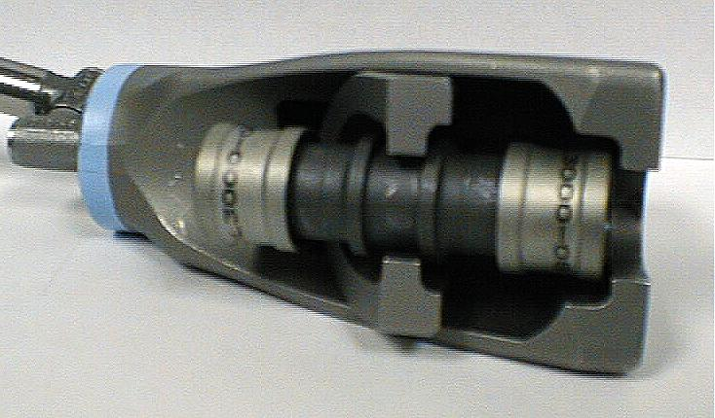
Designed Metal Connections
PermaLite
Technical Brief &
Installation Procedure
SOP604-008
Rev. AA
October 2007
Lee Bullock

Slide 2
Designed Metal Connections
Information in this Technical Brief is from DMC SOP604-008 PermaLite Installation & Inspection Procedure
Operators should consult Sikorsky S-92 Aircraft Maintenance Manual

Slide 3
Designed Metal Connections
When did it Begin ?
The Deutsch Company now DMC was founded in 1938 in Los Angeles, CA
Permaswage was founded in Paris to support European markets in 1974
DMC and Permaswage operate today as subsidiaries of Global Design Technologies

Slide 4
Designed Metal Connections
What is PermaLite?
  Construction Attributes
  Fitting Materials
Part Numbering Structure
Tool & Installation Procedure
1

Slide 5
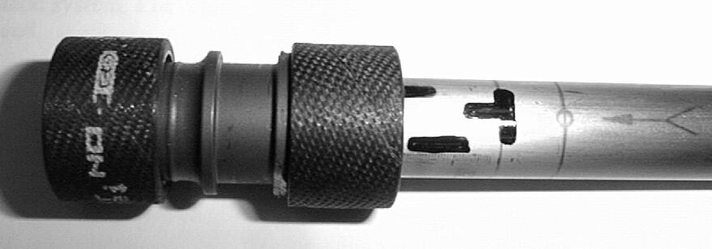
PermaLite is - Type of Fitting
PermaLite is an axially swaged fitting. Tool pushes ring up conical body surface to produce a swaging action.
Movement area
Ring
4

Slide 6
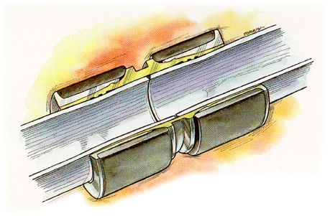

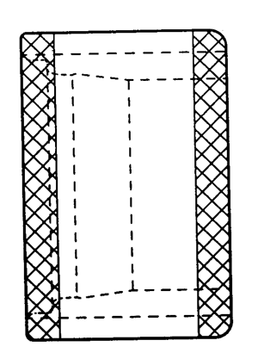
PermaLite Construction Attributes
Composite rings reduce stress in swaging ring
Composite rings reduce stress in swaging ring
No ovality
Composite rings reduce stress in swaging ring
No ovality
Metal to metal seal
Composite rings reduce stress in swaging ring
No ovality
Metal to metal seal
Lower shipset weight
Fitting Seal
Ring
3

Slide 7
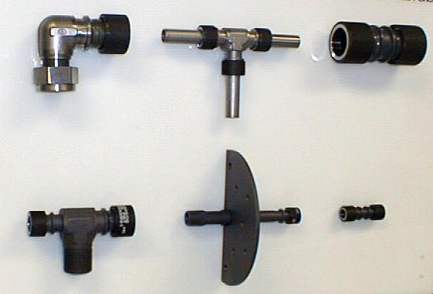
PermaLite Fitting Material
Aluminum PermaLite
  The only permanent fitting qualified on soft tubing (5052-0)
  All configurations, available for fuel system applications
Titanium PermaLite
  Qualified to 3000 psi, 4000 psi & 5000 psi
1

Slide 8
PermaLite Fitting Material
Stainless Steel PermaLite
  This fitting is also considered a repair fitting, up to 5000 psi
Verify Application
1

Slide 9
Designed Metal Connections
What is PermaLite?
  Construction Attributes
  Fitting Materials
Part Numbering Structure
Tool & Installation Procedure
1

Slide 10
1 of 3
PermaLite Part Numbering System
1 2 3 4
Typical Part Number
D P L 4 0 0 0 T 12 06 08 04 W
Separable Code
0=All ends are swage 1=Beam Seal 2= Flareless 3=Flared
Shape Code
0=Straight 1=45 Deg Elbow 2=90 Deg Elbow 3=Tee 4=Cross 5=Bulkhead Straight 6=Bulkhead 45 Deg Elbow 7=Bulkhead 90 Deg Elbow 8=Bulkhead Tee
Pressure Code
1=1,000PSI 3=3,000PSI 4=4,000PSI 5=5,000PSI E=500PSI U=1,500PSI
PermaLite products prefix (1 to 4 characters)

Slide 11
2 of 3
PermaLite Part Numbering System
Typical Part Number
5 6
D P L 4 0 0 0 T 12 06 08 04 W
Material Code D = Aluminum Alloy 6061 T = Titanium Alloy 6Al-4V - = Stainless Steel 21-6-9
Configuration Code
0 = Nonreducer, port 1 female separable or all ends are swage
1 = Reducer, port 1 female separable or all ends are swage
2 = Nonreducer, female separable on side (tee, port 3)
3 = Reducer, female separable on side (tee, port 3)
4 = Nonreducer, port 1 male separable or bulkhead
5 = Reducer, port 1 male separable or bulkhead
6 = Nonreducer, male separable or bulkhead on side (tee, port 3)
7 = Reducer, male separable or bulkhead on side (tee, port 3)

Slide 12
3 of 3
PermaLite Part Numbering System
7 8 9 10 11
Typical Part Number
D P L 4 0 0 0 T 12 06 08 04 W
(Optional)Nuts with lock wire holes
Port 4: (Opposite port 3) for cross
Port 3: Side (tee) or largest remaining end for cross
Port 2: Opposite port 1
Port 1: Separable or largest end (on run for tees)

Slide 13
Designed Metal Connections
What is PermaLite?
  Construction Attributes
  Fitting Materials
Part Numbering Structure
Tool & Installation Procedure
1

Slide 14
Six Steps to using the PermaLite System
1-
2-
3-
Cut Tube to desired length
Deburr tube
Apply fitting position mark and inspection mark using the tool and pen supplied
Slide fitting on tube, locating it on the positioning mark
Position the DAT Tool onto the fitting, swage
Inspect swaged fitting
4-
5-
6-

Slide 15
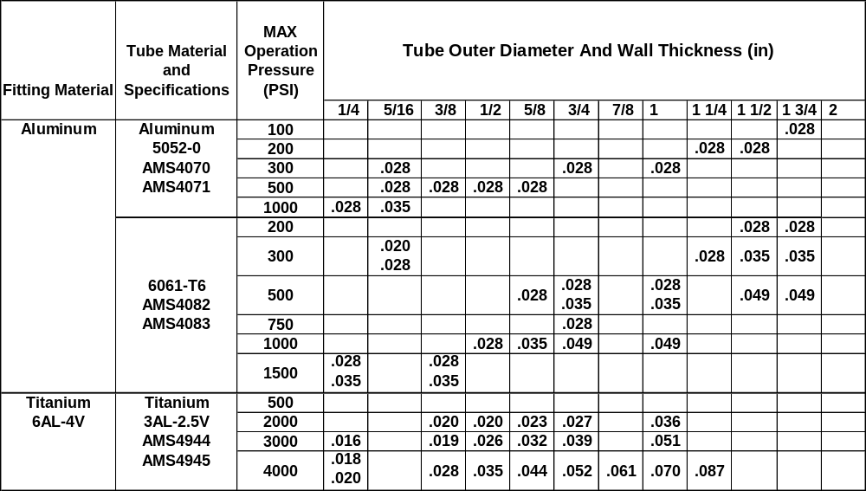
PermaLite Installation
Check SOP604-008 for approved PermaLite Fitting Tube Combination

Slide 16
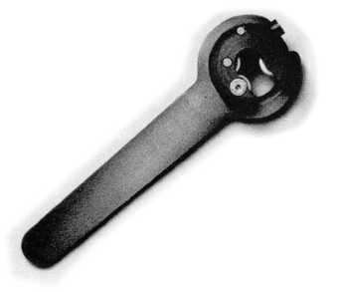
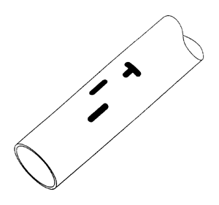
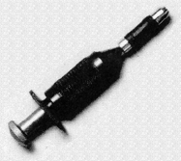
PermaLite Installation
Tube Condition:
Tube Condition:
Tube seal area shall be free of cracks, splits, seams, folds, scratches or any other imperfection that is detrimental to the performance of the swaged joint.
Tube Condition:
Tube seal area shall be free of cracks, splits, seams, folds, scratches or any other imperfection that is detrimental to the performance of the swaged joint.
Tube ends shall be deburred
Manual
Cutter
2

Slide 17
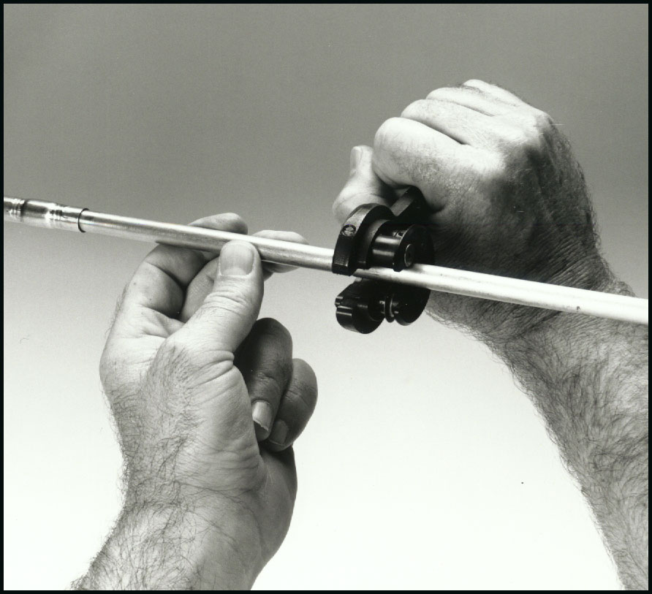
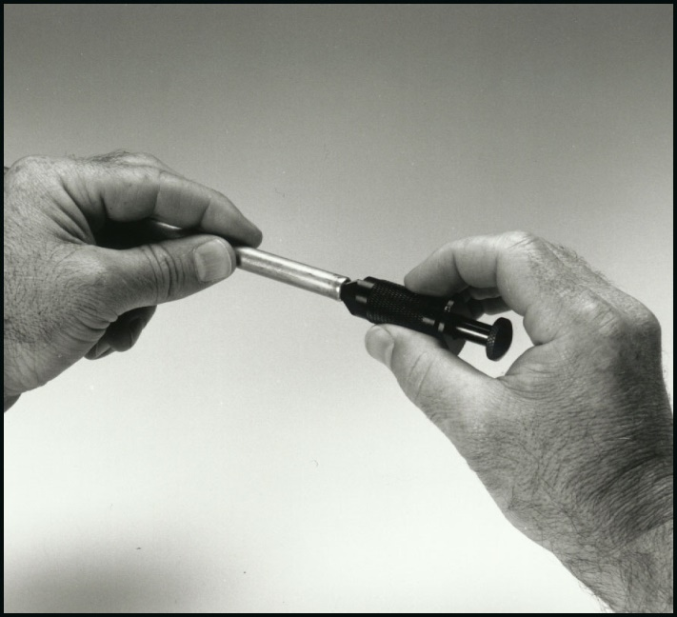
Permalite Installation
Deburring Tool
Manual
Cutter
Cut tube with DMC Chipless Tube Cutter
Deburr Tube with DMC Deburring Tool

Slide 18
Six Steps to using the PermaLite System
1-
2-
3-
Cut Tube to desired length
Deburr tube
Apply fitting position mark and inspection mark using the tool and pen supplied
Slide fitting on tube, locating it on the positioning mark
Position the DAT Tool onto the fitting, swage
Inspect swaged fitting
4-
5-
6-

Slide 19
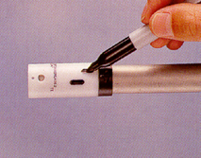
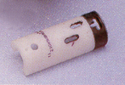
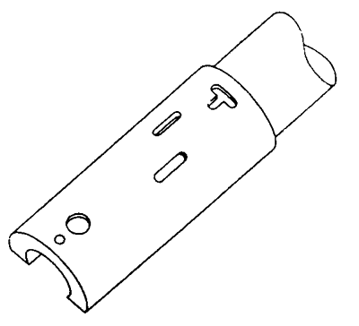

PermaLite Installation
Location of Tube
Insertion Marks
1.Select the proper marking template
1.Select the proper marking template
2. Use the sight hole to ensure that the marking template fits flush against the tube end.
1.Select the proper marking template
2. Use the sight hole to ensure that the marking template fits flush against the tube end.
3. Using a marking pen, make a mark in each slot three (3) marks total by running the pen along the sides of the slot.
Sight
Hole
Verification
Mark
Positioning
Mark
Inspection
Mark
Marking
Template
3

Slide 20
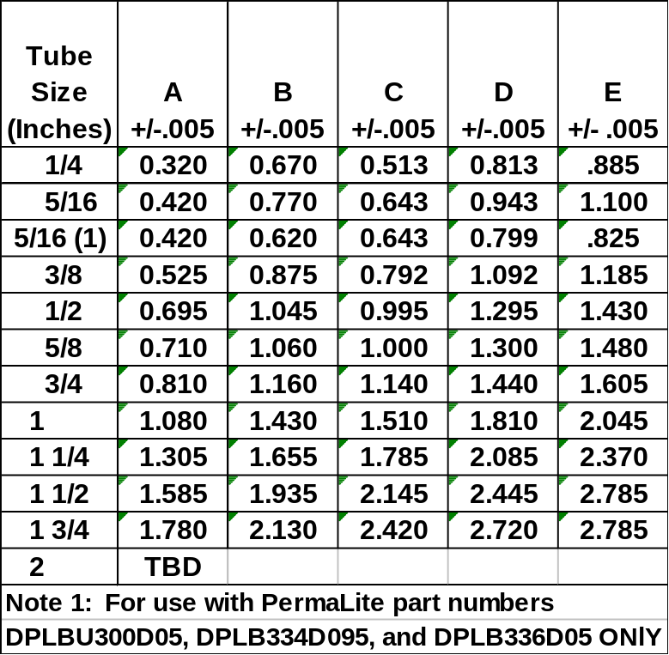
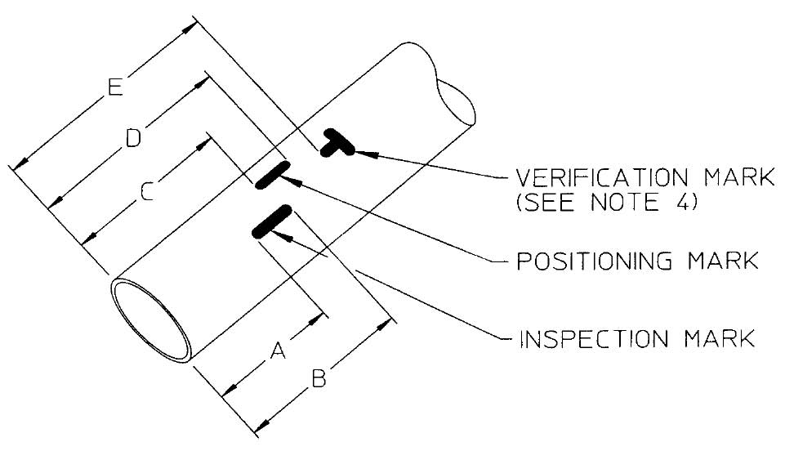
PermaLite Installation
Location of Tube
Insertion Marks
Aluminum Insertion Mark End Locations
There is another table for Titanium
3

Slide 21
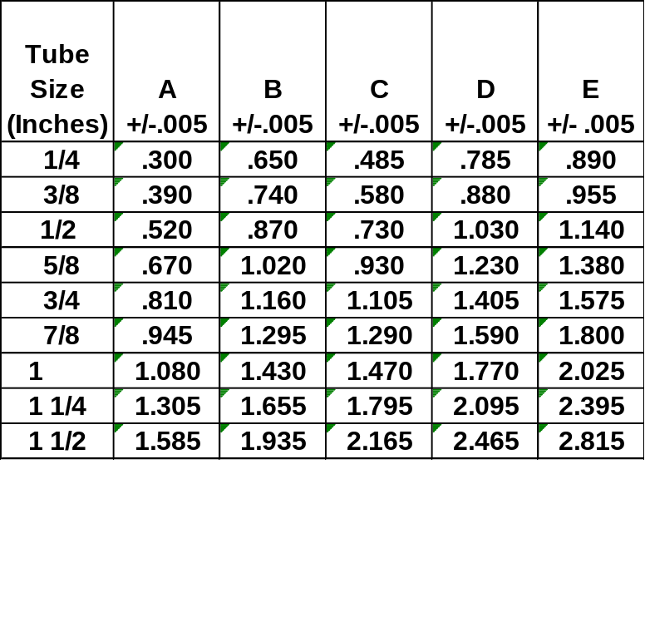
PermaLite Installation
Location of Tube
Insertion Marks
Titanium Insertion Mark End Locations
There is another table for Aluminum
3

Slide 22
PermaLite Installation
Location of Tube
Insertion Marks
(Ideal location of the end of the fitting prior to swaging)
Positioning Mark
Verification
Mark
Inspection
Mark
Note:
Positioning mark is located
in the middle of the three
insertion marks.
1

Slide 23
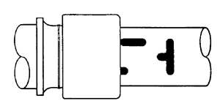
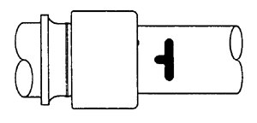
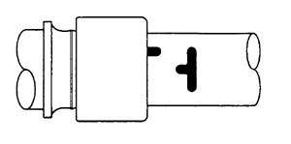
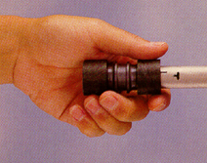
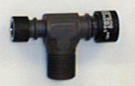
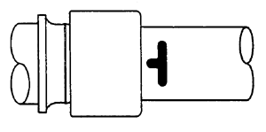
PermaLite Installation
Fitting Position Prior to swaging
Note:
Tubing shall be properly
aligned to avoid pre-load.
Minimum Insertion
Maximum Insertion (Typical)
Average Insertion
Can ONLY be used
with fittings that have
TUBE STOPS.
Maximum Insertion
5

Slide 24
Six Steps to using the PermaLite System
1-
2-
3-
Cut Tube to desired length
Deburr tube
Apply fitting position mark and inspection mark using the tool and pen supplied
Slide fitting on tube, locating it on the positioning mark
Position the DAT Tool onto the fitting, swage
Inspect swaged fitting
4-
5-
6-

Slide 25
PermaLite Tooling
Small size
Good access
Does not enclose tubes
Can be used in both push & pull positions
Easy installation
Swivel and extension hydraulic hose
2

Slide 26

PermaLite Installation Caution
This tooling is subject to high pressure and forces during its operation. KEEP FINGERS AWAY from moving parts (Tool jaws and PermaLite fitting if present) when pressuring the tool.
Always ensure that the PermaLite fitting is properly positioned within the tool before and during the swaging process. Improper use may result in tool failure and/or personal injury.
1

Slide 27
PermaLite Installation Caution
USE ONLY the hoses, Quick Disconnects (QD) and swivels supplied in DMC kits
DO NOT:
Hold tool by the QD or hose - damage may result.
2

Slide 28
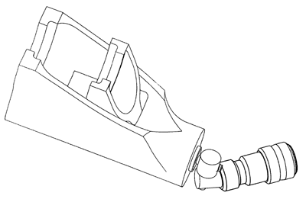
PermaLite Installation Tool
Fixed Jaw
Moveable Jaw
Slot
1. Select proper tool
1. Select proper tool
2. Inspect tooling for good working condition
1. Select proper tool
2. Inspect tooling for good working condition
3. Areas to check
  Check the area between and around the jaws to ensure that there is no dirt or other debris lodged in the tool.
1. Select proper tool
2. Inspect tooling for good working condition
3. Areas to check
  Check the area between and around the jaws to ensure that there is no dirt or other debris lodged in the tool.
  Pay particular attention to the slot that guides the moveable jaw
1. Select proper tool
2. Inspect tooling for good working condition
3. Areas to check
  Check the area between and around the jaws to ensure that there is no dirt or other debris lodged in the tool.
  Pay particular attention to the slot that guides the moveable jaw.
  Check the jaws and surrounding areas to ensure that there are no cracks, nicks or dings.
1. Select proper tool
2. Inspect tooling for good working condition
3. Areas to check
  Check the area between and around the jaws to ensure that there is no dirt or other debris lodged in the tool.
  Pay particular attention to the slot that guides the moveable jaw.
  Check the jaws and surrounding areas to ensure that there are no cracks, nicks or dings.
4. Attach the DMC 10,000 PSI hydraulic hose and pump.
Swivel
Quick Disconnect

Slide 29
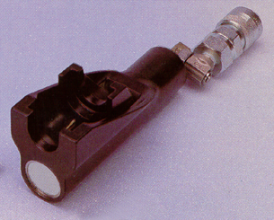
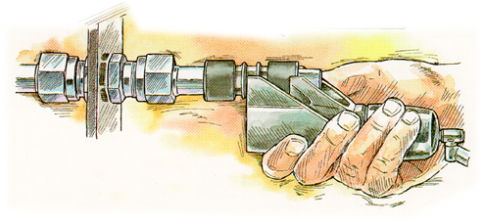
PermaLite Installation
Swaging
Operations
Notes:
1. Tooling must be allowed access such that its location is not restricted by any structure adjacent to the fitting being swaged.
1. Tooling must be allowed access such that its location is not restricted by any structure adjacent to the fitting being swaged.
2. Every tool is capable of swaging a fitting in either the push or pull position, HOWEVER, not all fittings can be swaged in the pull position
3. Using the tool in the pull position requires special attention to ensure that the fitting does not move during the swaging process.
1. Tooling must be allowed access such that its location is not restricted by any structure adjacent to the fitting being swaged.
2. Every tool is capable of swaging a fitting in either the push or pull position, HOWEVER, not all fittings can be swaged in the pull position
3. Using the tool in the pull position requires special attention to ensure that the fitting does not move during the swaging process.
4. It is recommended that at least one end of a fitting be swaged in the push position.
1. Tooling must be allowed access such that its location is not restricted by any structure adjacent to the fitting being swaged.
2. Every tool is capable of swaging a fitting in either the push or pull position, HOWEVER, not all fittings can be swaged in the pull position.
1. Tooling must be allowed access such that its location is not restricted by any structure adjacent to the fitting being swaged.
2. Every tool is capable of swaging a fitting in either the push or pull position, HOWEVER, not all fittings can be swaged in the pull position
3. Using the tool in the pull position requires special attention to ensure that the fitting does not move during the swaging process.
4. It is recommended that at least one end of a fitting be swaged in the push position
5. In the case of a separable fitting, fasten before attempting a swage in the pull position.
5

Slide 30
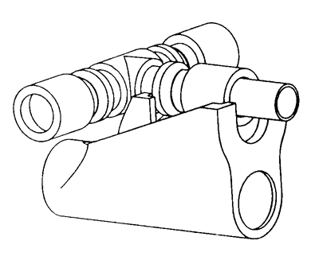
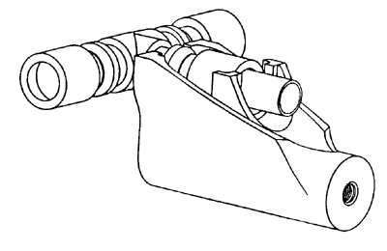
PermaLite Installation
Swaging
Operations
Moveable Jaw interferes
with forging body.
Fitting ring is
nested within Jaws
Tube and top
of Jaw are
almost flush
Pull
Position
Fitting groove is NOT
bottomed against swage tool
Push Position
Not Acceptable
Acceptable
An exception to using the tool in the Pull Position
4

Slide 31
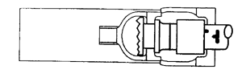
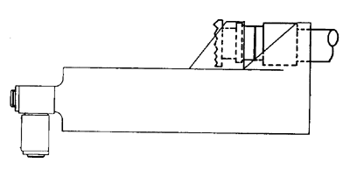
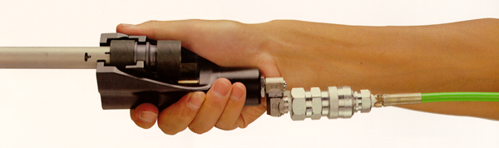
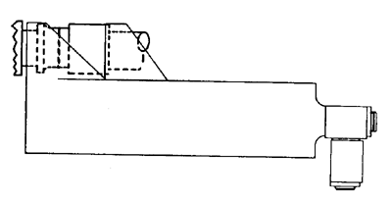
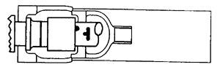
PermaLite Installation
Swaging
Operations
Fitting seated
in JAWS
Tool and fitting must be aligned
Under NO circumstance shall the tool be forced into position or cocked.
Pull
Position
Push
Position
Actuate the pump until the pressure gage is in “green.”
As pressure builds the jaw advances.
Release pressure. Jaw will retract.
10
2

Slide 32
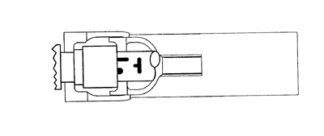
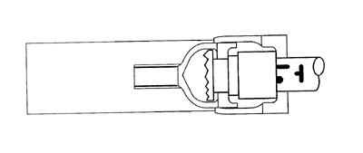
PermaLite Installation
Swaging
Operations
Ring FULLY advanced
flush with fitting flange
Tool
Pull Position
Push Position
1

Slide 33
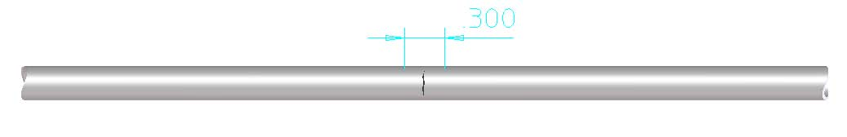
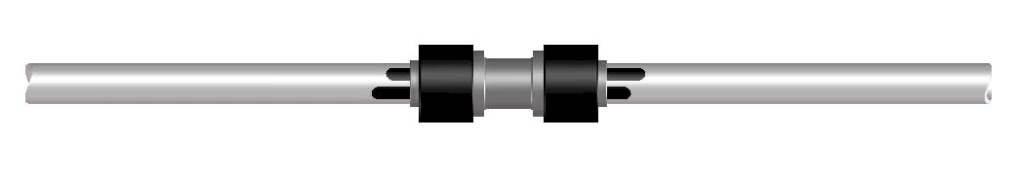
THREE TUBING REPAIR TECHNIQUES
A. TYPE 1--Small Hole or Short Crack in Tube shorter tan .300
DAMAGED SECTION
COMPLETED REPAIR

Slide 34
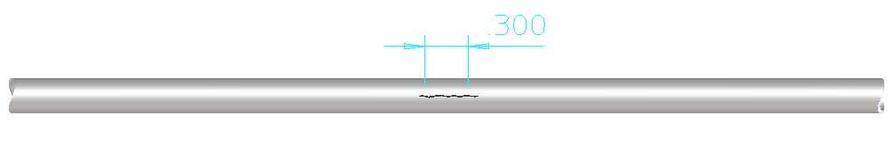
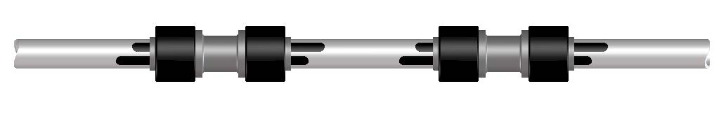
THREE TUBING REPAIR TECHNIQUES
B. TYPE 2--Lengthwise Crack in Tube (Crack Longer Than 0.30")
DAMAGED SECTION
COMPLETED REPAIR

Slide 35
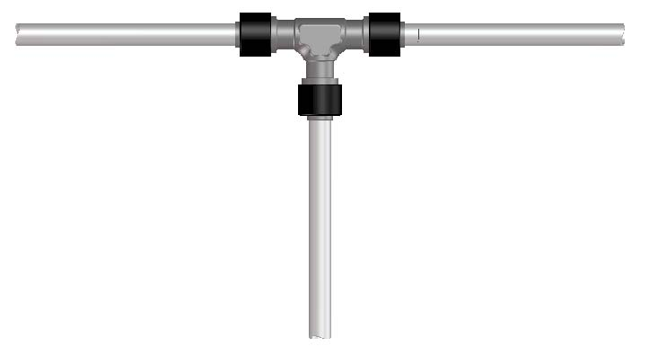
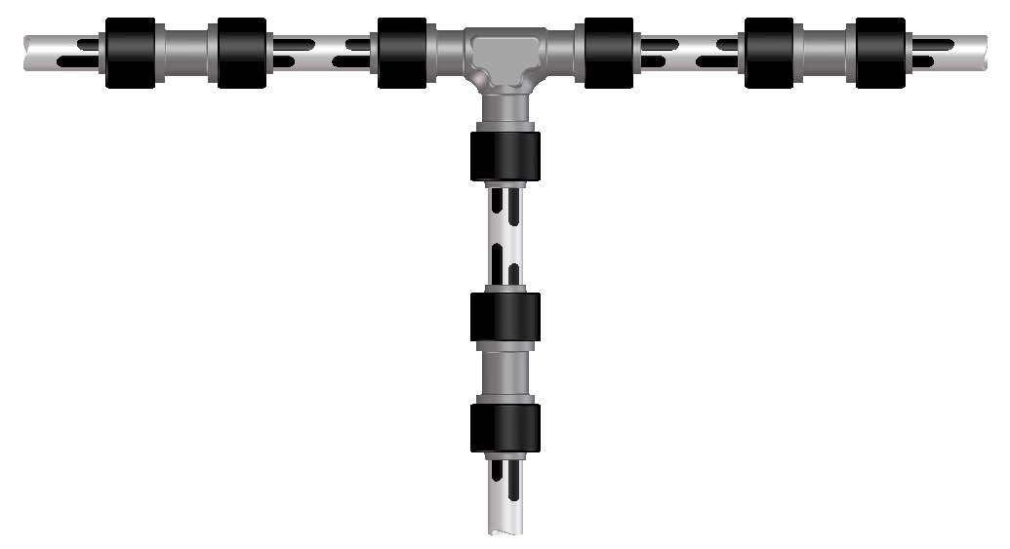
THREE TUBING REPAIR TECHNIQUES
C. TYPE 3--Leaking Elbow, Tee, or Cross
DAMAGED SECTION
COMPLETED REPAIR

Slide 36
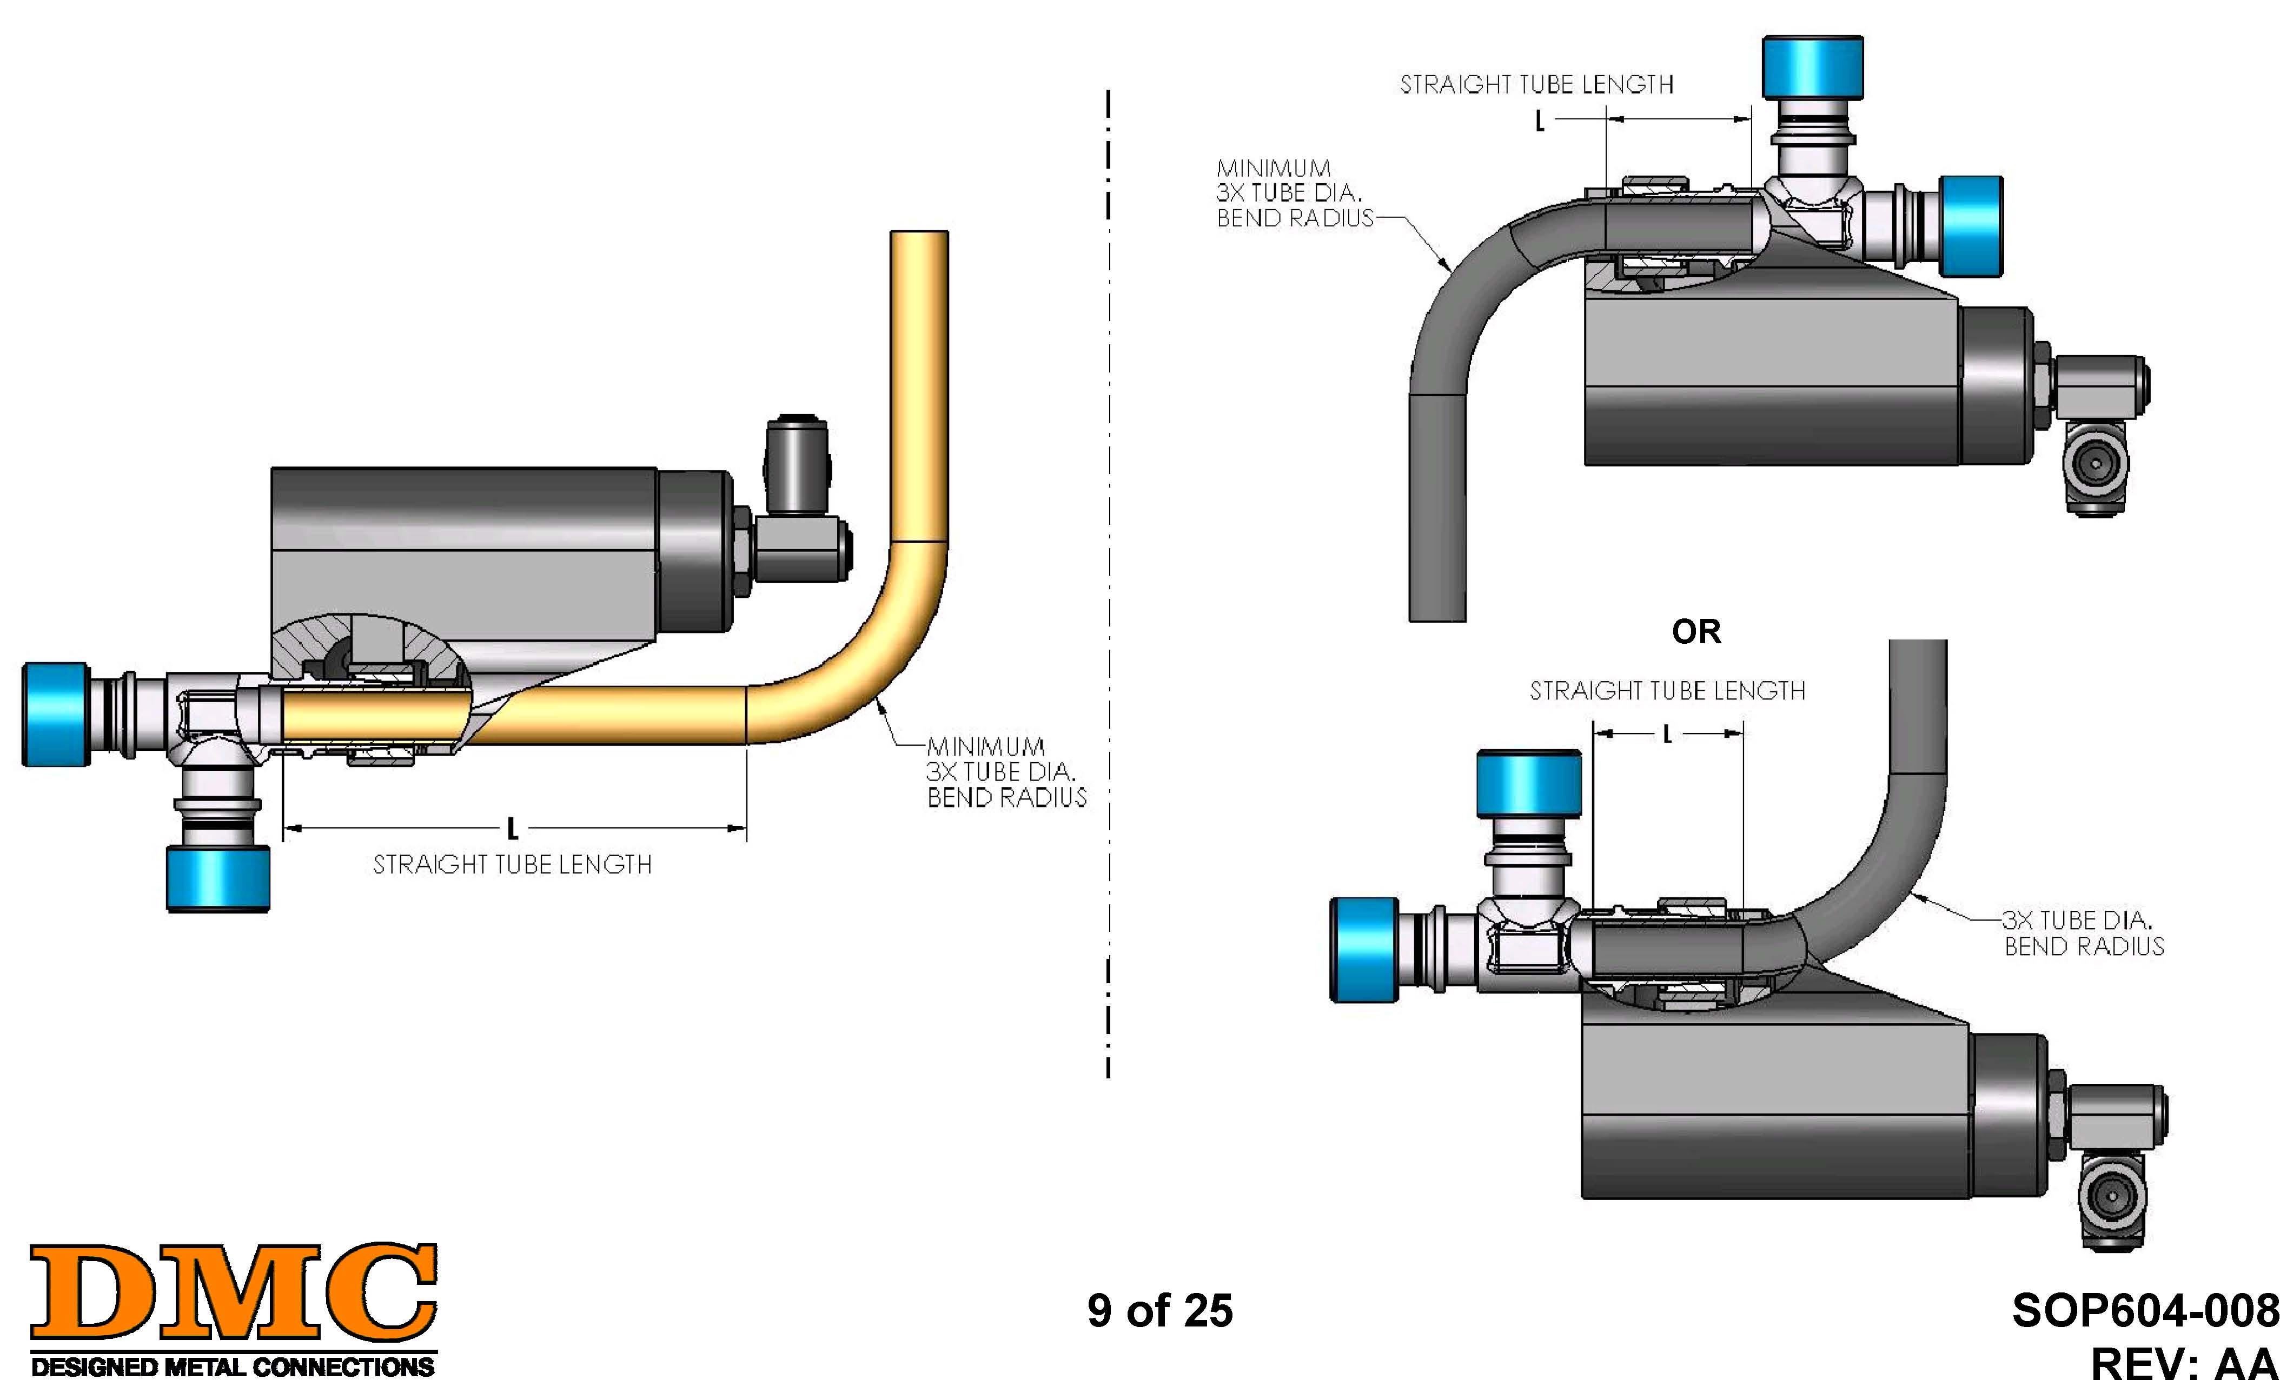
PermaLite Installation
CONFIGURATION II
MINIMUM STRAIGHT TUBE LENGTHS
CONFIGURATION I

Slide 37
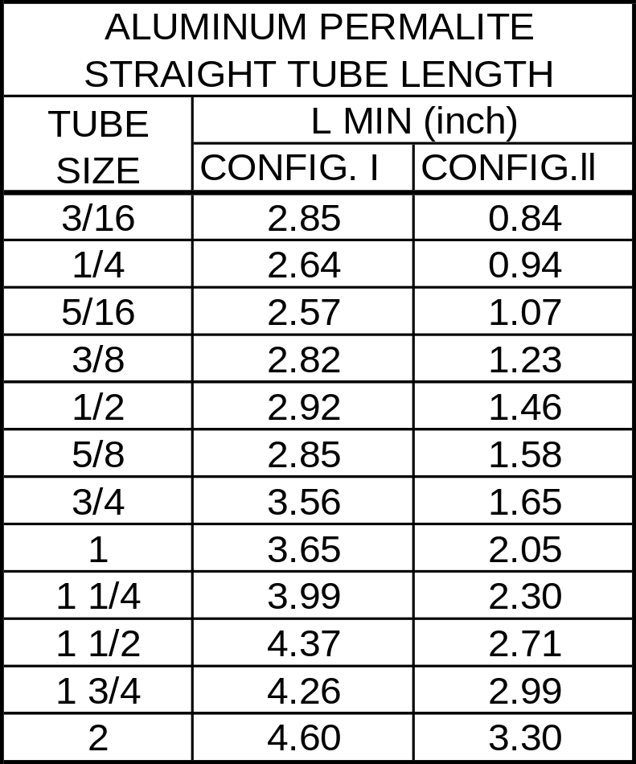
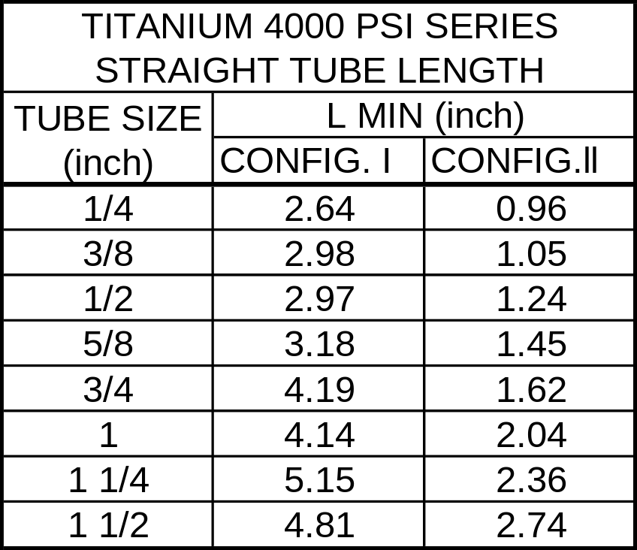
PermaLite Installation
MINIMUM STRAIGHT TUBE LENGTHS PER SOP604-008

Slide 38
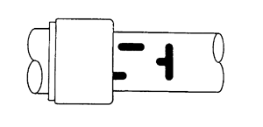
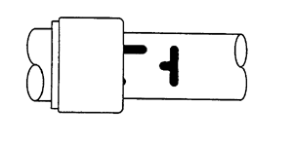
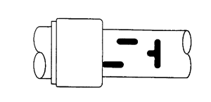
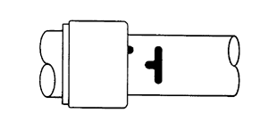
PermaLite Installation
Tube
Position After
Swaging
Average Insertion
Maximum Insertion
Minimum Insertion
Maximum Insertion W/Tube Stop
5

Slide 39
Six Steps to using the PermaLite System
1-
2-
3-
Cut Tube to desired length
Deburr tube
Apply fitting position mark and inspection mark using the tool and pen supplied
Slide fitting on tube, locating it on the positioning mark
Position the DAT Tool onto the fitting, swage
Inspect swaged fitting
4-
5-
6-

Slide 40
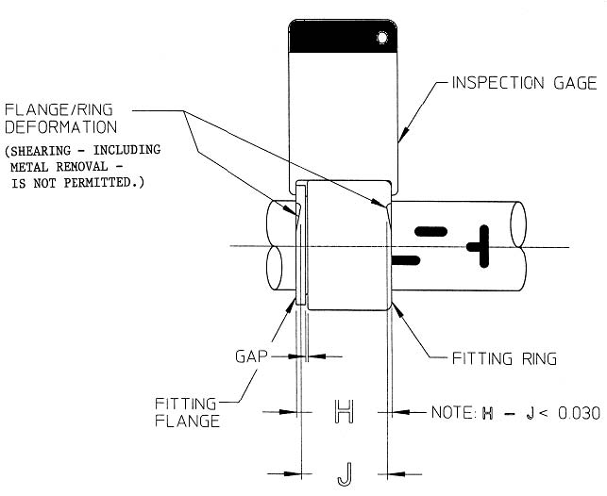
PermaLite Inspection
Place the inspection gage onto the
completed swage.
The gage should fit all around the
fitting ring/flange WITHOUT
forcing it.

Slide 41
PermaLite Installation Inspection
Average Insertion
Maximum Insertion
Visually inspect the position of the swaged fitting on the tube.
At least two (2) marks should be visible in whole or part.
If NOT, the tube was inserted too far into fitting.
Minimum Insertion
Maximum Insertion W/Tube Stop

Slide 42
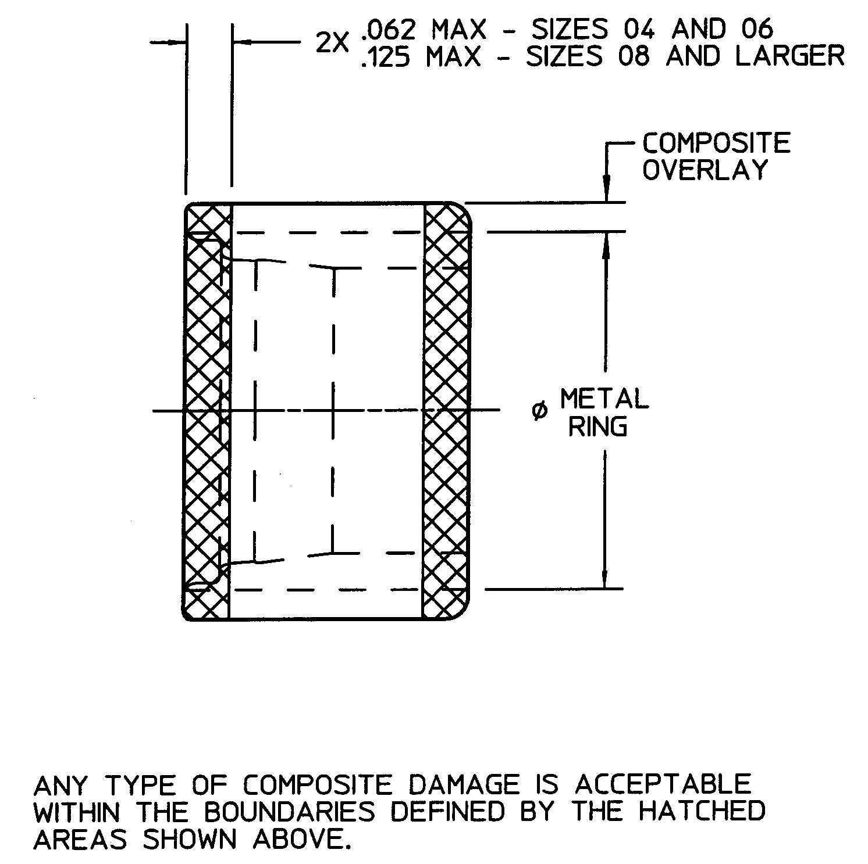
PermaLite Installation
Ring
Overlay Allowable
Damage
Any type of composite damage
including the complete removal
of the composite overlay is
ACCEPTABLE within the
boundaries defined by the
hatched areas shown.

Slide 43
DMC is ready to Support Sikorsky’s S-92 in North America
Western Region
John Cowden
Tel (661) 722-7125
jcowden@dmcusa.com
Bill Dyer PermaLite Product Manager Tel (310) 323-6200
Bdyer@dmcusa.com
Central/Midwest
Mike Bond
Tel (618) 234-0405
Mbond1@earthlink.net
Northeast
Lee Bullock
Tel (603) 447-6001
LeeBullock@earthlink.net
Government Programs
John Walsh
Tel (937) 299-3688
aussie@erinet.com
Southeast
Gene Kowalczyk
Tel (706) 854-9873
gkowalczyk@earthlink.net

Slide 44
DMC is ready to Support Sikorsky S-92 in South America
Bill Dyer – PermaLite Product Manager
Designed Metal Connections 14800 South Figueroa St.
Gardena, CA 90248
Tel (310) 323-6200
Fax (310) 329-2505

Slide 45
DMC is ready to Support Sikorsky’s S-92 in the Pacific Rim
Kevin Connor
Designed Metal Connections
6 Bodalla Cr, Bangor
Australia, 2234
Ph: ++(61) 2-9543-1701
email: kevcon1@bigpond.com

Slide 46

Permaswage is ready to Support Sikorsky S-92 in Europe, Asia & India
Inside Sales: Ms Marie-Luce Grenet (marieluce.grenet@permaswage.com )
Logistics: Mrs Ruth Langlois
(ruth.langlois@permaswage.com )
Tooling: Mr J. Baque (jerome.baque@permaswage.com )
Product Support: Mr Lee Roberts
(lee.roberts@permaswage.com )
Product Support: Mr Paul Kemp
(paul.kemp@permaswage.com)
Tel: 011 33 1 30 79 17 20
Fax: 011 33 1 34 81 02 21

Slide 47


S-92 PermaLite Kits
PermaLite Field Repair Kit DAT02AEFKT4009 4000psi Ti Fittings Sizes -04,-06,-08,-10,-12,-16
PermaLite Alum Kit DAT03AEKT4033 (No Pump) Size -08 S-92 Floatation
Portable kit W/wheels
Kit Open W/Pump & Tools

